Slide 1

Scalable ML Model for Detecting Suspicious Transactions

Slide 2

TEAM
BALLA SHIVARAM
(2103A52003-Batch 27 -CSE (AI and ML))
EDAMA SAIKRISHNA REDDY
(2103A52014-Batch 25-CSE(AI and ML))
KAMATHAM RAHUL
(2103A52020-Batch 27-CSE(AI and ML))
SABBANI UDAY
(2103A52183-Batch24-CSE(AI and ML))

Slide 3
INTRODUCTION
Financial fraud is a growing concern for banking institutions, payment services, and digital transaction platforms. Fraudulent transactions can cause significant financial losses and erode customer trust. Traditional rule-based fraud detection systems struggle with scalability and adaptability to evolving fraud patterns.
Financial Fraud is a Growing Concern- Financial fraud is increasing, with traditional rule-based systems failing to detect sophisticated fraudulent transactions.
Challenges with Existing Fraud Detection Methods-use evolving tactics, making it difficult to identify anomalies.

Slide 4
PROBLEM STATEMENT:
Financial fraud is increasing due to the rise in digital transactions.
Traditional rule-based fraud detection methods are inefficient and unable to adapt to evolving fraud techniques
Machine learning models offer better fraud detection but often suffer from imbalanced datasets and high false positive rates.
There is a need for a robust, scalable, and real-time fraud detection system to minimize risks.
This research proposes a hybrid machine learning approach (XGBoost + Random Forest) to enhance detection accuracy and efficiency.

Slide 5
EXISTING SOLUTIONS:
Limitations:
1. Rigid Rule-Based Systems: Struggle to adapt to new fraud patterns.
2. High False Positives: Anomaly detection may flag legitimate transactions.
3. **Computational Cost: Deep learning models require extensive resources.
Capabilities:
1. Adaptive Learning: ML models improve with more data over time.
2. Pattern Recognition: Deep learning detects complex fraud behaviors.

Slide 6
OBJECTIVE
To Develop an Accurate Fraud Detection Model.
To Analyze Transaction Patterns & Anomalies.
To Use Supervised & Unsupervised Learning Techniques.
To Ensure Scalability & Real-Time Processing.
To Evaluate and Optimize Model Performance.
To Develop an API for Deployment .

Slide 7
PROPOSED SOLUTIONS:
Model Selection & Training
Implement a hybrid fraud detection system combining rule-based, machine learning, and deep learning approaches to improve accuracy and efficiency.
Utilize pre-trained machine learning models (e.g., Random Forest, Isolation Forest, Autoencoders, LSTMs) trained on large transaction datasets to detect anomalies and fraudulent activities.
Key Innovations
Adaptive Fraud Detection: Combines supervised and unsupervised learning to detect both known and emerging fraud patterns.
Sequential Pattern Analysis: Uses LSTMs and CNNs to analyze transaction sequences and identify unusual behaviors.

Slide 8
PROPOSED SOLUTIONS:
Fraud Prevention Mechanisms
Dynamic Thresholding: Unlike fixed rule-based systems, dynamically adjusts fraud detection thresholds based on evolving patterns.
Explainable AI (XAI): Enhances transparency in fraud detection, ensuring fair decision-making.
Applications
Banking & Finance: Prevent unauthorized transactions and financial fraud.
E-Commerce & Payments: Detect unusual purchase behavior in online transactions.
Cybersecurity & Compliance: Monitor user activity to prevent identity theft and money laundering.

Slide 9
LITERATURE REVIEW:
R. J. Bolton & D. J. Hand (2002) – Proposed unsupervised anomaly detection using statistical models to detect fraudulent credit card transactions.
S. Bhattacharyya et al. (2011) – Developed a hybrid fraud detection model combining random forests, logistic regression, and neural networks to improve classification performance in detecting financial fraud.
M. Zareapoor & P. Shamsolmoali (2015) – Used data mining techniques like decision trees and support vector machines (SVM) for real-time fraud detection in banking transactions, achieving improved accuracy with feature selection.
A. Goyal et al. (2018) – Investigated the use of deep learning models, specifically LSTMs and CNNs, to analyze transaction sequences and identify fraudulent patterns in real-time payment systems.
J. West & M. Bhattacharya (2019) – Applied graph-based machine learning methods to detect fraudulent activities by analyzing the relationships between transactions and identifying suspicious network patterns.

Slide 10
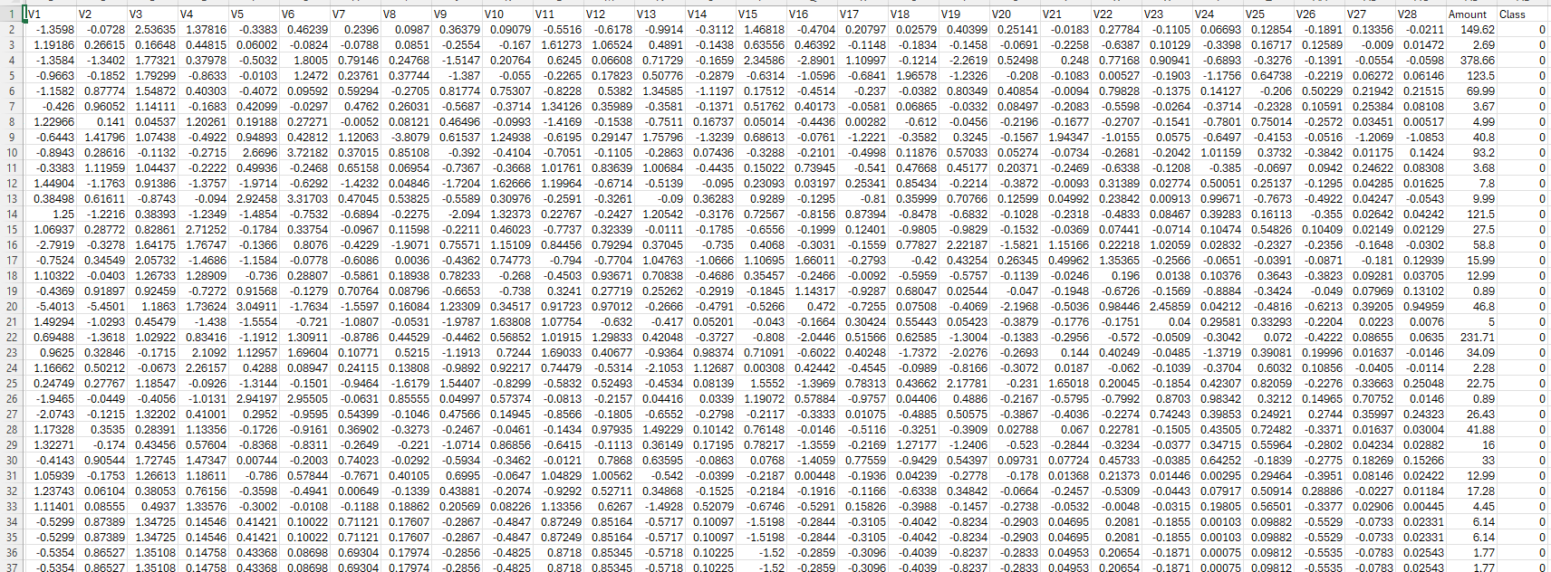
DATA SET
The dataset is a credit card fraud detection dataset with anonymized transaction features (V1–V28) derived from PCA. It includes the "Amount" column for transaction value and "Class" as the target (0 = legitimate, 1 = fraudulent). The goal is to build models for detecting fraudulent transactions.

Slide 11
MODELS USED
Logistic Regression: A linear model for binary classification that estimates the probability of a class using a logistic function.
Random Forest Classifier: An ensemble learning method that constructs multiple decision trees and aggregates their outputs to enhance accuracy and reduce overfitting.
Decision Tree Classifier: A deep learning model composed of multiple neuron layers that capture complex fraud patterns through non-linear transformations.
XGB Classifier: An advanced gradient boosting algorithm that iteratively builds decision trees to optimize fraud detection performance while handling class imbalance effectively..

Slide 12
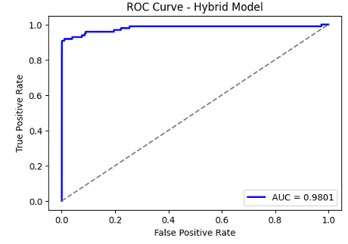
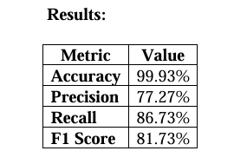
Hybrid Model (XGBoost + Random Forest) – Proposed
Model
XGBoost: High predictive power and strong handling of imbalanced data.
Random Forest: Adds stability and reduces variance by combining multiple trees.

Slide 13
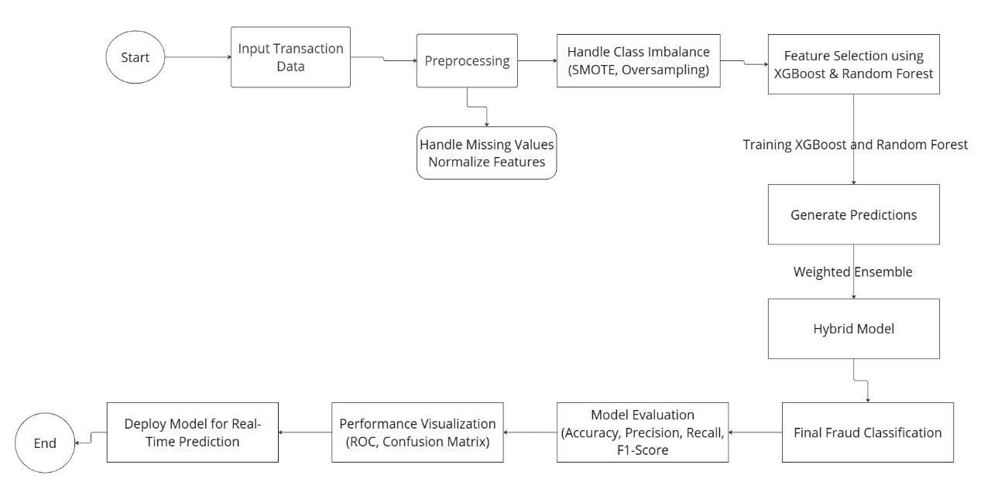
FLOW CHART

Slide 14
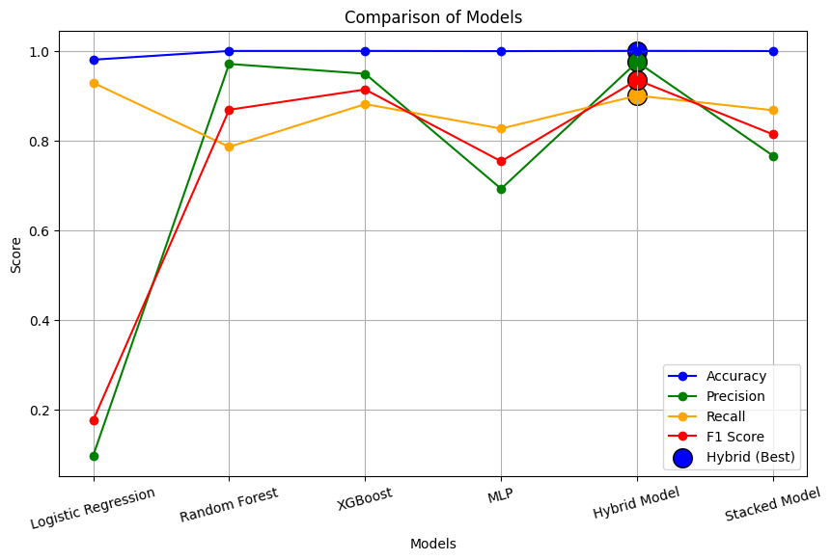
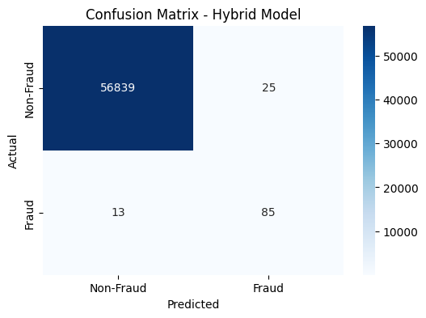
OUTPUT:

Slide 15
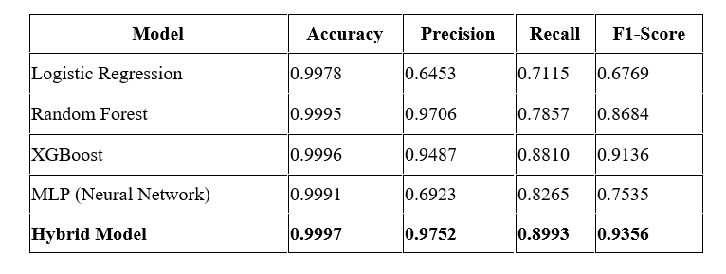
OUTPUT:

Slide 16
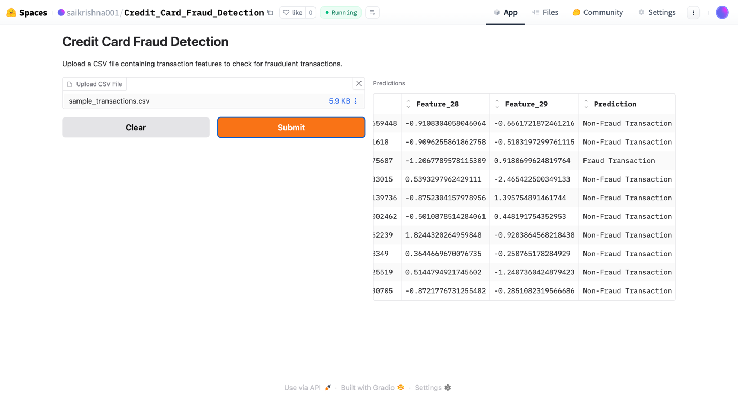
OUTPUT:

Slide 17
CONCLUSION
Financial fraud detection is a critical challenge in today’s digital world, where fraudulent transactions can lead to severe economic losses. Traditional rule-based methods are no longer sufficient to combat evolving fraud techniques. In this study, we proposed a hybrid machine learning model combining XGBoost and Random Forest, leveraging their strengths to improve fraud detection accuracy while minimizing false positives.
Through extensive experimentation, our hybrid model demonstrated superior performance across key evaluation metrics such as accuracy, precision, recall, and F1-score, outperforming individual models like Logistic Regression, Decision Tree, and standalone Random Forest or XGBoost. The comparative analysis and experimental results validate the effectiveness of the proposed model in detecting fraudulent transactions efficiently.
Additionally, we deployed the model using Hugging Face, making it accessible for real-world applications. The deployment ensures scalability and ease of integration with financial systems for real-time fraud detection.

Slide 18

Thank You

